Slide 1
Project, Application, Build, and Jobs

Slide 2
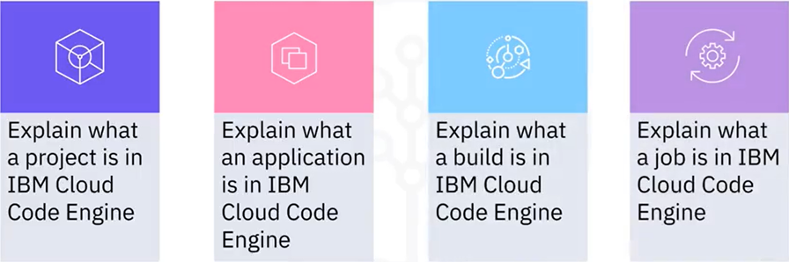
What you will learn

Slide 3
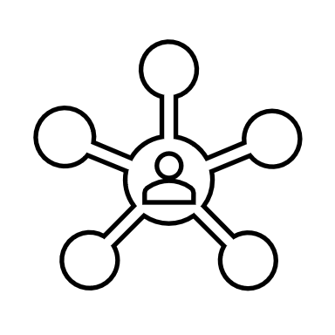



Project
Grouping
namespace: my_id/my_project/
Build
App
Job
Certificate

Slide 4
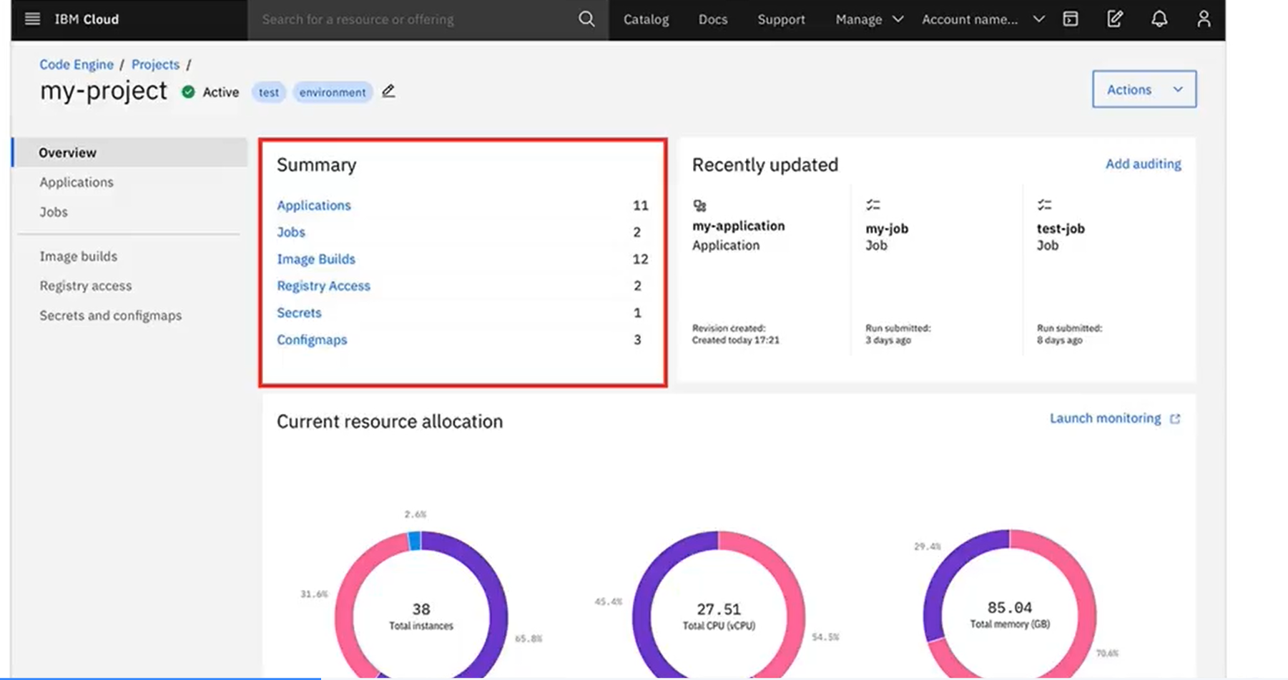

Slide 5
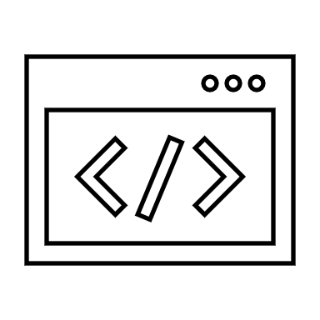
Application
Code Engine Application
App Instance 2
HTTP
WebSocket
HTTP
App Instance 1
WebSocket
HTTP
App Instance 3
WebSocket

Slide 6
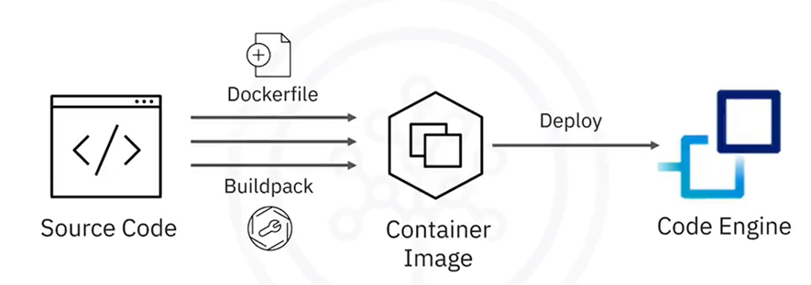
Build

Slide 7


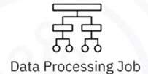

Job
Job Instance 2
Job Instance 1

Slide 8
Recap
In this video, you learned that:
• A project is a grouping of Code Engine entities such as
applications, jobs, and builds
• An application runs your code to serve HTTP requests or to
create WebSocket sessions
• A build is a process to create a container image from your
source code
• A job runs one or more instances of your executable code

